Slide 1

SPARK

Slide 2
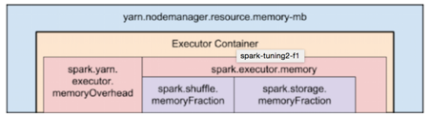
Contents
Configure number of Executors
Spark Cluster Configuration
Configure memory: Drivers & Executors

Slide 3
Spark Cluster Configuration
To fine tune Spark jobs, you can provide custom Spark configuration properties in a cluster configuration.
On the cluster configuration page, click the Advanced Options toggle.
Click the Spark tab.
spark-submit --class <CLASS_NAME> --num-executors ? --executor-cores ? --executor-memory ? ....

Slide 4
Working Process
spark-submit –master <Spark master URL> –executor-memory 2g –executor-cores 4 WordCount-assembly-.py
Let’s say a user submits a job using “spark-submit”.
“spark-submit” will in-turn launch the Driver which will execute the main() method of our code.
Driver contacts the cluster manager and requests for resources to launch the Executors.
The cluster manager launches the Executors on behalf of the Driver.
Once the Executors are launched, they establish a direct connection with the Driver.
The driver determines the total number of Tasks by checking the Lineage.
The driver creates the Logical and Physical Plan.
Once the Physical Plan is generated, Spark allocates the Tasks to the Executors.
Task runs on Executor and each Task upon completion returns the result to the Driver.
Finally, when all Task is completed, the main() method running in the Driver exits, i.e. main() method invokes sparkContext.stop().
Finally, Spark releases all the resources from the Cluster Manager.

Slide 5
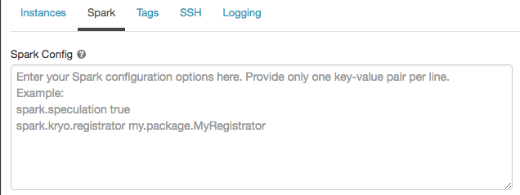
In Spark config, enter the configuration properties as one key-value pair per line.
When you configure a cluster using the Clusters API, set Spark properties in the spark_conf field in the Create cluster request or Edit cluster request.

Slide 6
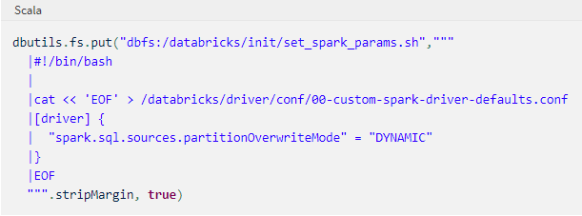
To set Spark properties for all clusters, create a global init script:

Slide 7
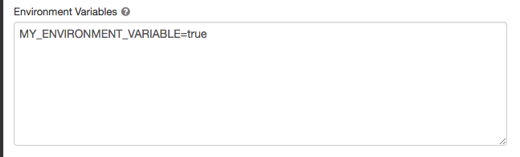
Environment variables
You can set environment variables that you can access from scripts running on a cluster.
On the cluster configuration page, click the Advanced Options toggle.
Click the Spark tab.
Set the environment variables in the Environment Variables field.

Slide 8
You can also set environment variables using the spark_env_vars field in the Create cluster request or Edit cluster request Clusters API endpoints.
The environment variables you set in this field are not available in Cluster node initialization scripts. Init scripts support only a limited set of predefined Init script execution order.

Slide 9
Cluster tags
Cluster tags allow you to easily monitor the cost of cloud resources used by various groups in your organization. You can specify tags as key-value pairs when you create a cluster, and Databricks applies these tags to cloud resources like VMs and disk volumes, as well as DBU usage reports.
For clusters launched from pools, the custom cluster tags are only applied to DBU usage reports and do not propagate to cloud resources. For detailed information about how pool and cluster tag types work together, see Monitor usage using cluster and pool tags.
For convenience, Databricks applies four default tags to each cluster: Vendor, Creator, ClusterName, and ClusterId.

Slide 10
For convenience, Databricks applies four default tags to each cluster: Vendor, Creator, ClusterName, and ClusterId.
In addition, on job clusters, Databricks applies two default tags: RunName and JobId. On resources used by Databricks SQL, Databricks also applies the default tag SqlEndpointId.
You can add custom tags when you create a cluster.
To configure cluster tags:
On the cluster configuration page, click the Advanced Options toggle.
At the bottom of the page, click the Tags tab.

Slide 11
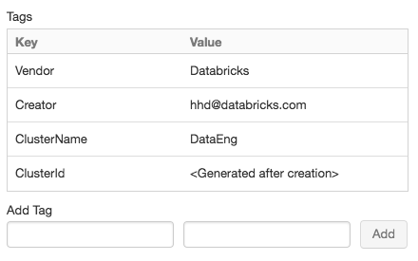
Add a key-value pair for each custom tag. You can add up to 45 custom tags.

Slide 12
SSH access to clusters
SSH allows you to log into Apache Spark clusters remotely for advanced troubleshooting and installing custom software.
This section describes how to configure your AWS account to enable ingress access to your cluster with your public key, and how to open an SSH connection to cluster nodes.

Slide 13
Configure security group
You must update the Databricks security group in your AWS account to give ingress access to the IP address from which you will initiate the SSH connection.
You can set this for a single IP address or provide a range that represents your entire office IP range.
In your AWS console, find the Databricks security group. It will have a label similar to <databricks-instance>-worker-unmanaged. (Example: dbc-fb3asdddd3-worker-unmanaged)
Edit the security group and add an inbound TCP rule to allow port 2200 to worker machines. It can be a single IP address or a range.

Slide 14
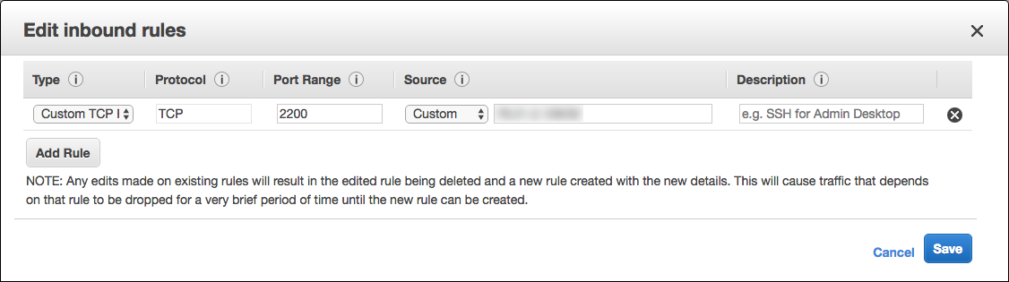
3. Make sure that your computer and office allow you to send TCP traffic on port 2200.

Slide 15

Generate SSH key pair
Create an SSH key pair by running this command in a terminal session:
You must provide the path to the directory where you want to save the public and private key. The public key is saved with the extension .pub.

Slide 16
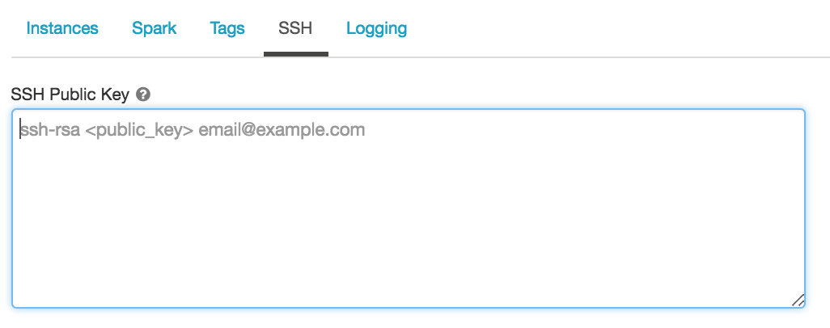
Configure a new cluster with your public key
Copy the entire contents of the public key file.
On the cluster configuration page, click the Advanced Options toggle.
At the bottom of the page, click the SSH tab.
Paste the key you copied into the SSH Public Key field.

Slide 17
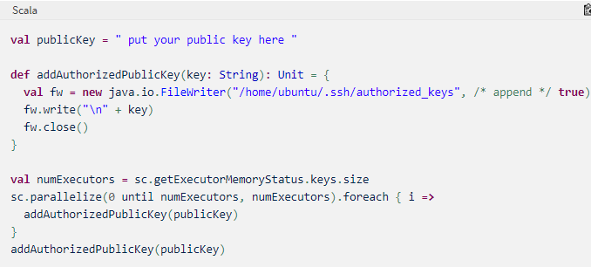
Configure an existing cluster with your public key
If you have a cluster and didn’t provide the public key during cluster creation, you can inject the public key by running this code from any notebook attached to the cluster:

Slide 18
Configuration Settings
spark.executor.instances: Number of executors for the spark application.
spark.executor.memory: Amount of memory to use for each executor that runs the task.
spark.executor.cores: Number of concurrent tasks an executor can run.
spark.driver.memory: Amount of memory to use for the driver.

Slide 19
spark.driver.cores: Number of virtual cores to use for the driver process.
spark.sql.shuffle.partitions: Number of partitions to use when shuffling data for joins or aggregations.
spark.default.parallelism: Default number of partitions in resilient distributed datasets (RDDs) returned by transformations like join and aggregations.

Slide 20
END OF SESSION
Q&A

